Slide 1
Hospital management system

Slide 2
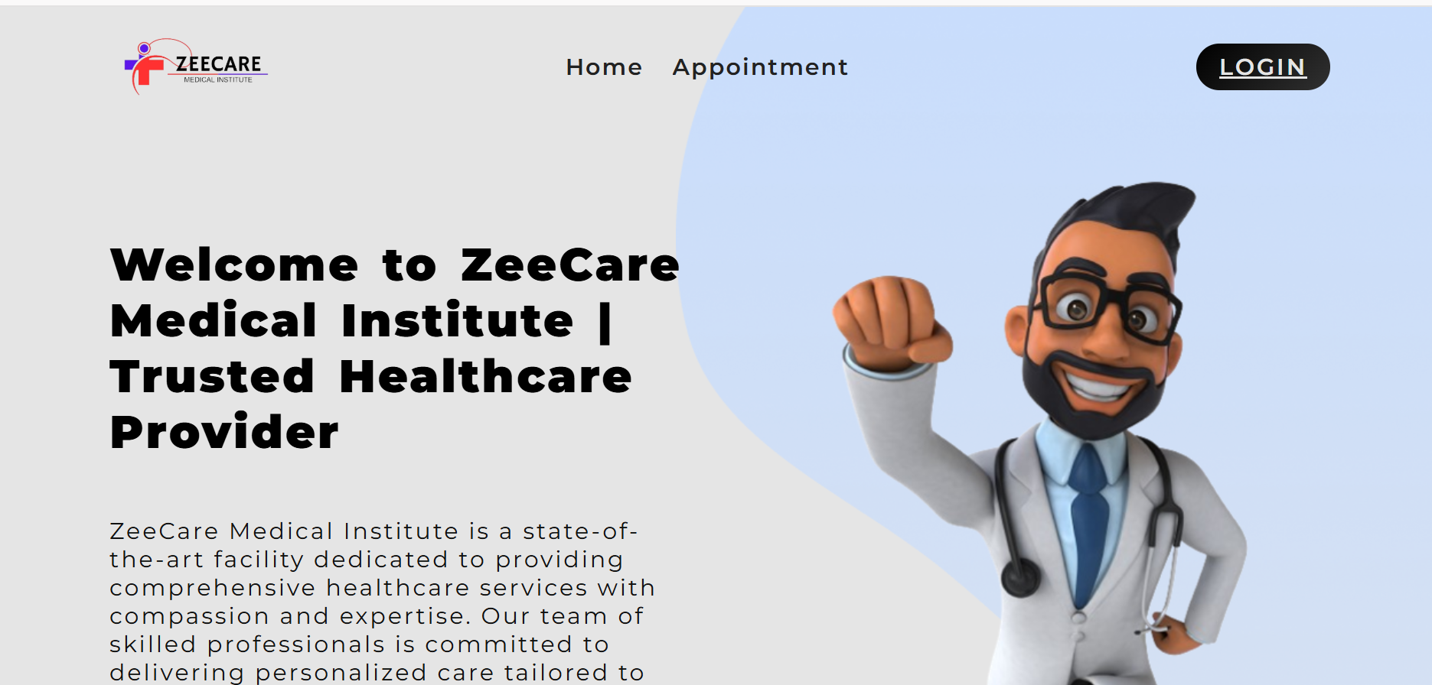
Key features
Authentication & Authorization:
User Profiles
Online Appointment Booking

Slide 3
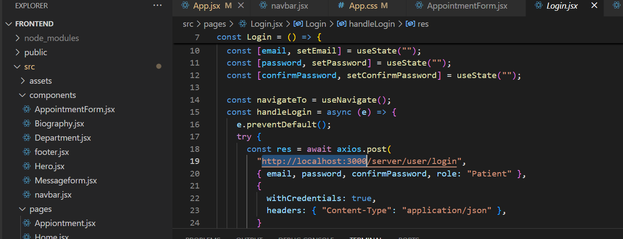
Technical details
Programming language: mern
IDE: visual studio
Modular design for scalability

Slide 4
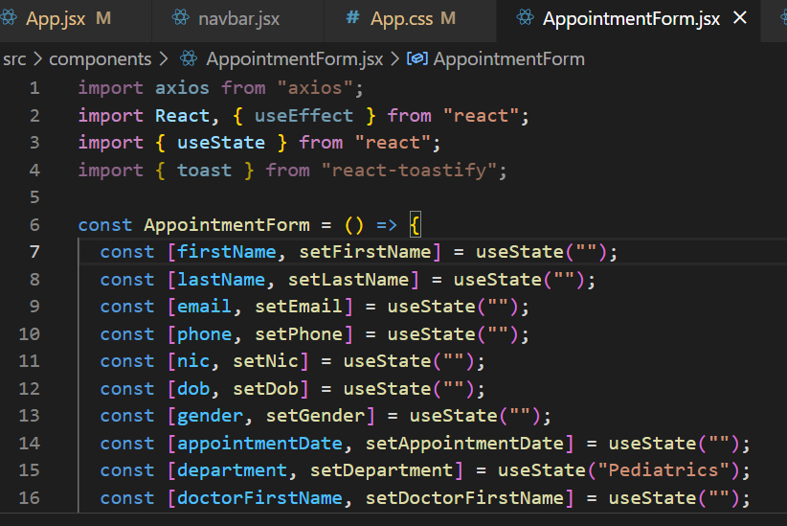
Core functionalities
**DatabaseConnection.java**: Manages secure database connections
- **homepage**: Central for user navigation
- **LOGIN**: Implements user authentication
- **Signin**: Handles user registration

Slide 5
Conclusion and Future Scope
Well-structured project with core functionalities
Can be expanded to include payment integration
Scalable for multi-user environments

